Slide 1
Leading cause of Cancer
Andrew Pfeifer

Slide 2
Causes of Cancer
There are many different causes that is believed to result in cancer. For this analyses we will look at 4 causes among age groups of cancer patients to decide if smoking is the leading cause of cancer. The variables we will cover are as follows:
Age – The respondent's age that has cancer.
Smoking – Smoking led to the respondent's cancer diagnosis.
Passive smoker – Smoking on occasions led to the respondent's cancer diagnosis.
Air Pollution – Air pollution led to the respondent's cancer diagnosis.
Obesity – Obesity led to the respondent's cancer diagnosis.

Slide 3
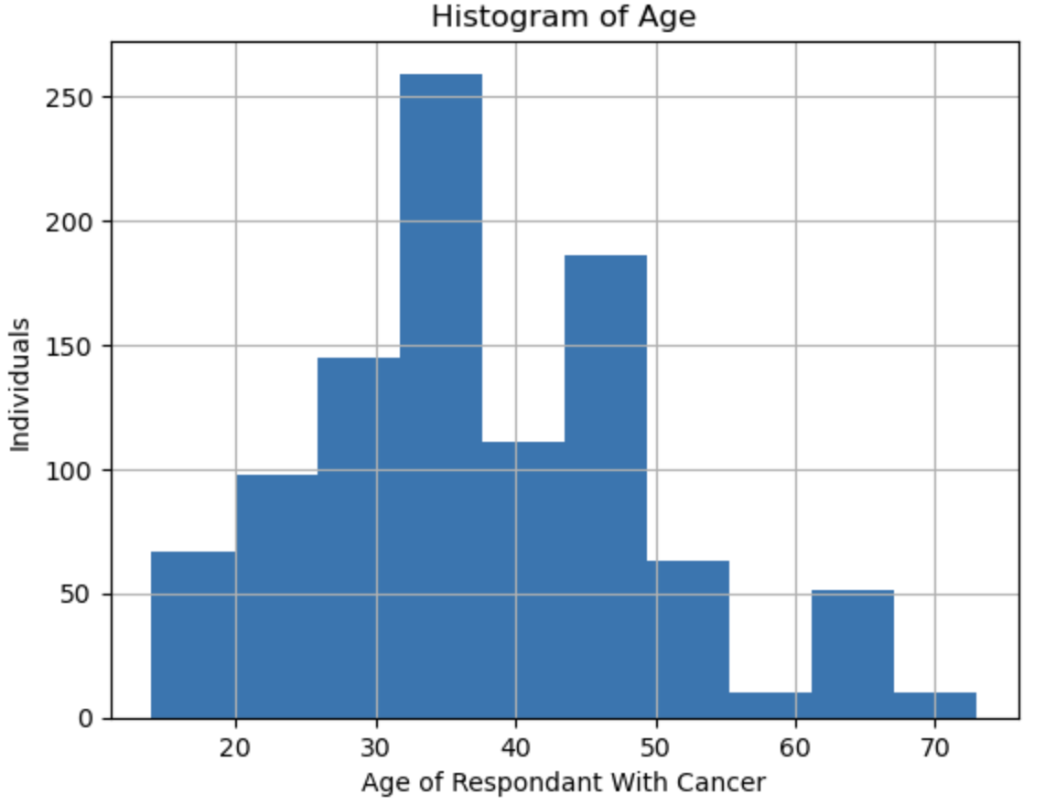
Histogram of Age

Slide 4
Analysis of The Age Histogram
The mode of this histogram is in the early 30's. Most of the cancer patients in this data set are younger than 35. However, this spikes again in the early 50s making this nearly bi-modal.
With the current data there appear to be no outliers.
The mean of this histogram should be slightly higher than the age of 35 but less than 50.
There is a good amount of spread in the data as Cancer doesn't have restrictions on age.
The tail towards the higher age bracket tends to drop off more quickly than the tail coming from the lower age brackets.

Slide 5
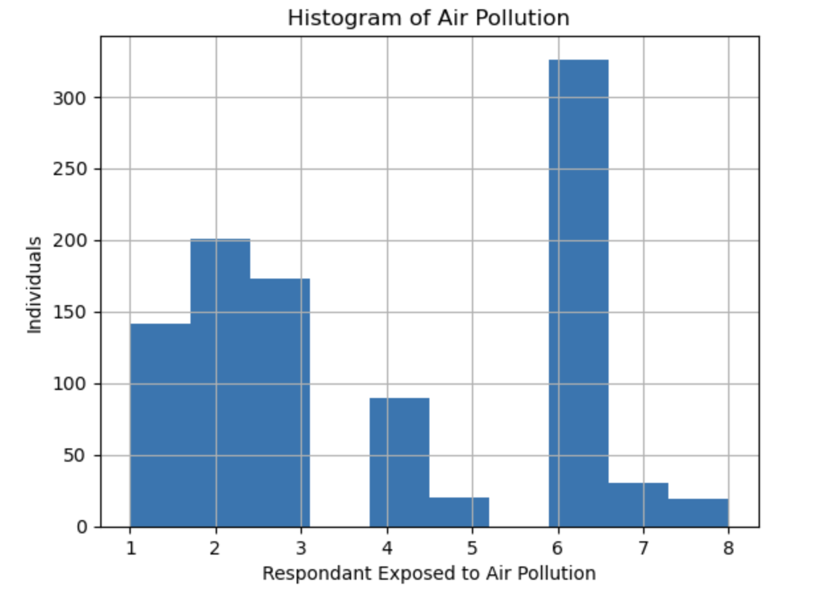
Histogram of Air Pollution

Slide 6
Analysis of The Air Pollution Histogram
The data value provided doesn’t have outliers as it's on a fixed scale of values.
The mode of this data set occurs at the level 6 exposure to air pollution.
The mean of this data sets occurs at the level 4 exposure.
There is less spread within this data set, it appears that either the respondent had a low exposure or a level 6 exposure.
The left tail has a smaller slope towards the mode while the tail to the right of the mode drops dramatically.

Slide 7
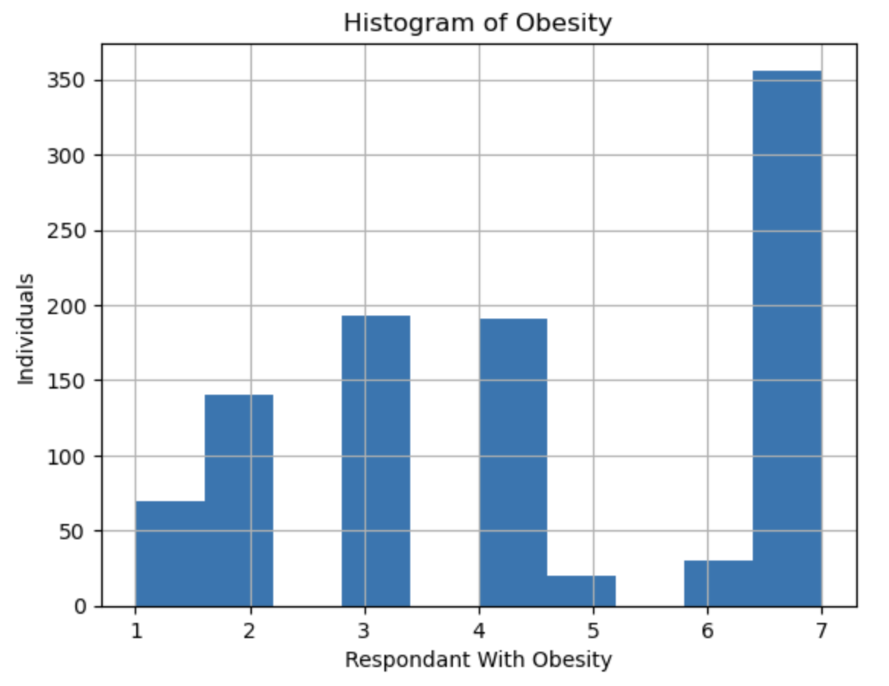
Histogram of Obesity

Slide 8
Analysis of The Obesity Histogram
This data set again should have no outliers due to the data being restricted to a fixed scale.
The mode occurs around the level 7 on the obesity scale. This would indicate most of the respondents are obese.
The Mean of the obesity scale occurs around 4.
For spread there is a relatively good amount of variance in this data. This seems to have the most diverse distribution thus far.
The left tail drops slowly from the mode. There is no right tail on this scale.

Slide 9
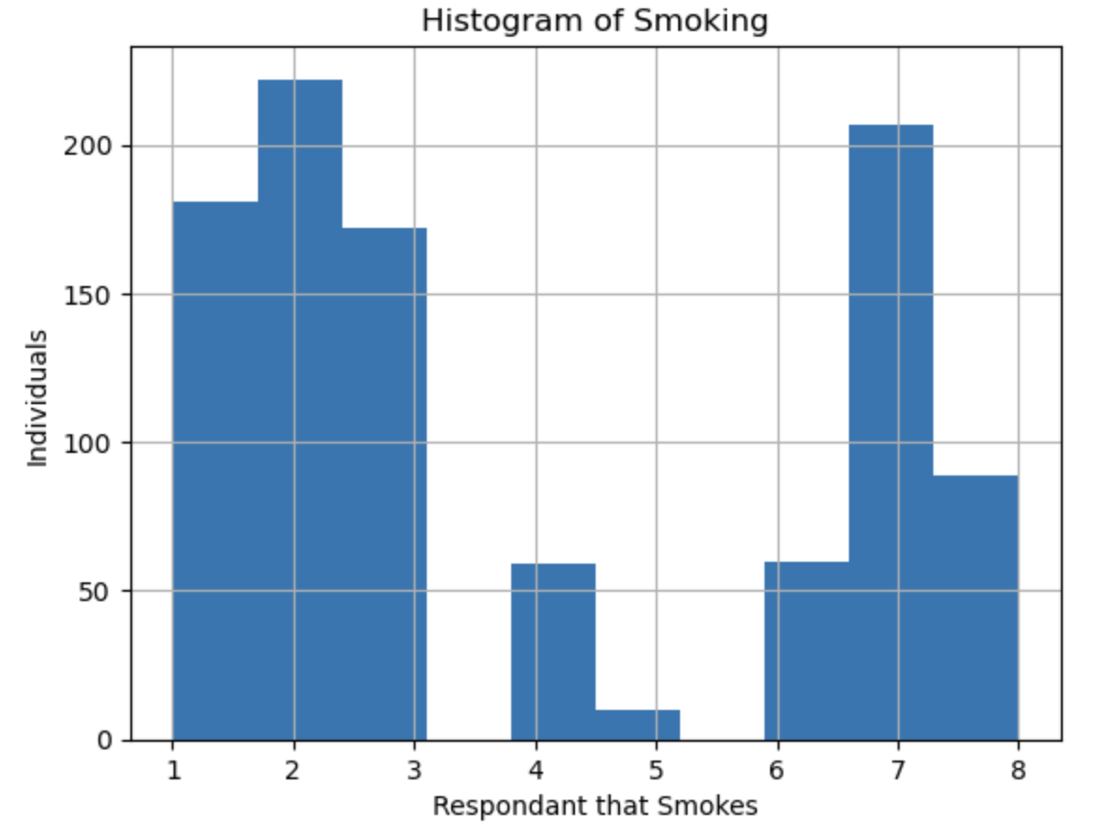
Histogram of Smoking

Slide 10
Analysis of The Smoking Histogram
This histogram appears to be bimodal. the first mode occurs at 2 while the second is at 7.
The mean sits at a level 4 exposure of smoking.
The left tail tends to drop dramatically to the mean while the right tail increases dramatically from the mean.
The spread of the data seems to be confined as the respondents are light smokers while others are heavy smokers.
There are no outliers in this histogram.

Slide 11
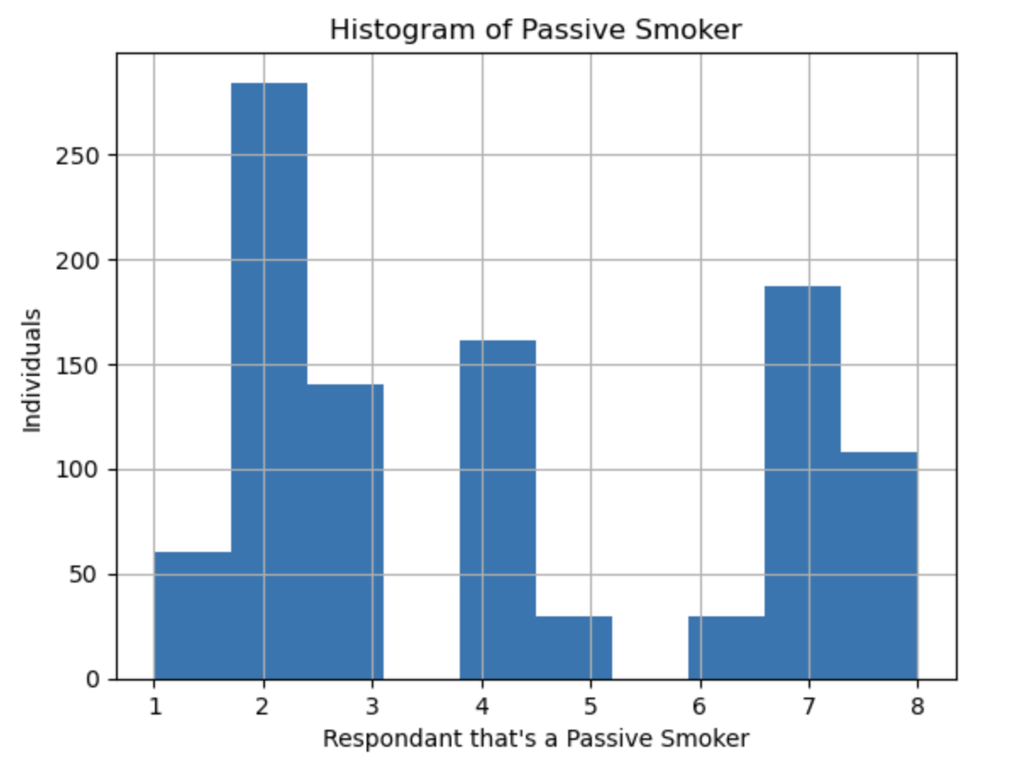
Histogram of Passive Smoking

Slide 12
Analysis of The Passive Smoking Histogram
The passive smoking histogram has a mode at 2.
The mean for passive smoking is at 4.
There is spread or variance in this data. The respondents don't all group up about the mode and they can fall into different levels of passive smoking.
The left tail increases dramatically to the mode while the right tail drops off slower from the mode.
There are no outliers on this histogram.

Slide 13
Comparing Histograms
All respondents in the data set have or had cancer. Age would be a good variable to compare to the remaining variables to determine which is more likely to lead to cancer based on age.
Each variable could be compared to one another, but if each variable isn't a good representative for the population of the cancer patients as each would need to apply to all directly.

Slide 14
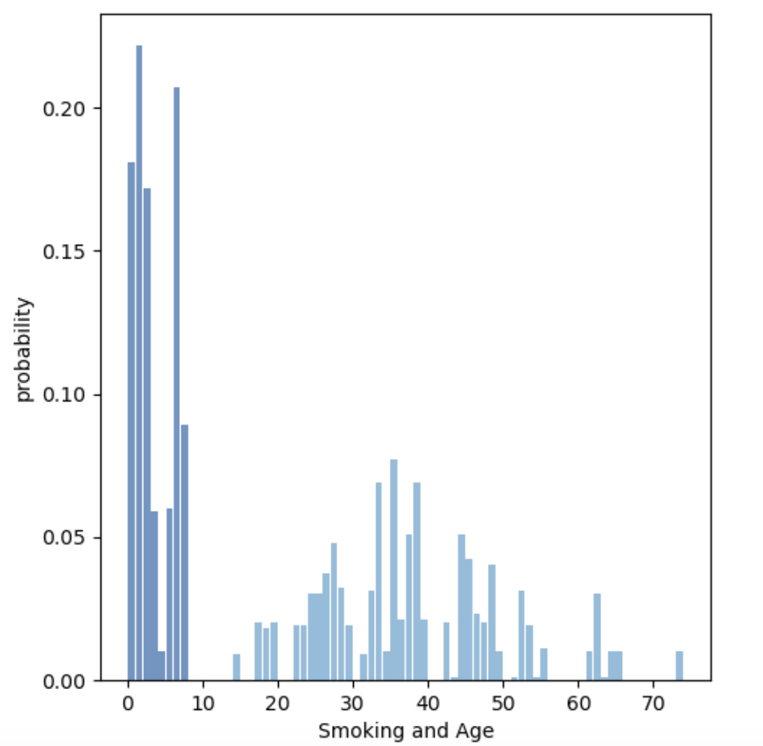
Smoking Vs Age

Slide 15
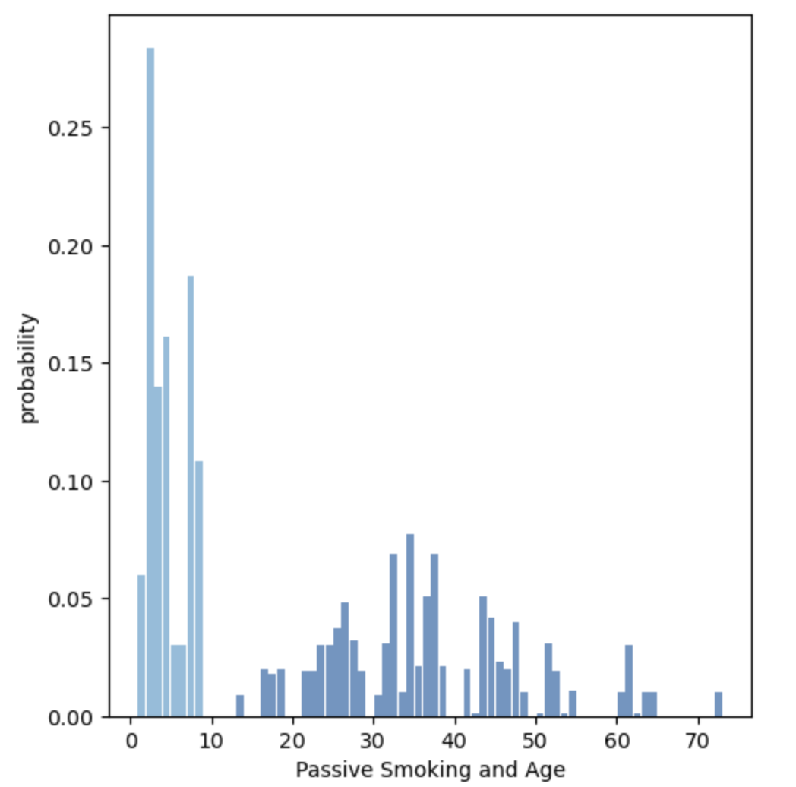
Passive Smoking vs Age

Slide 16
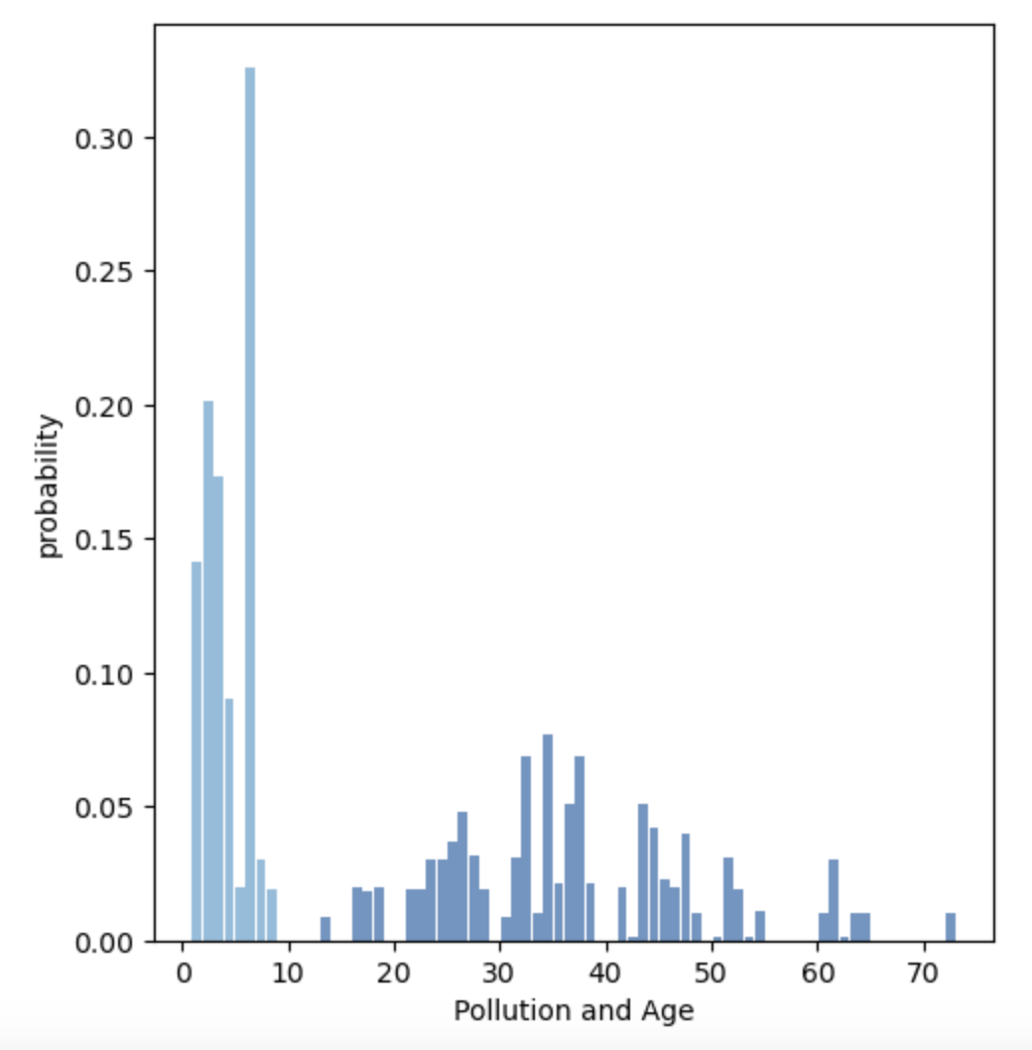
Air Pollution vs Age

Slide 17
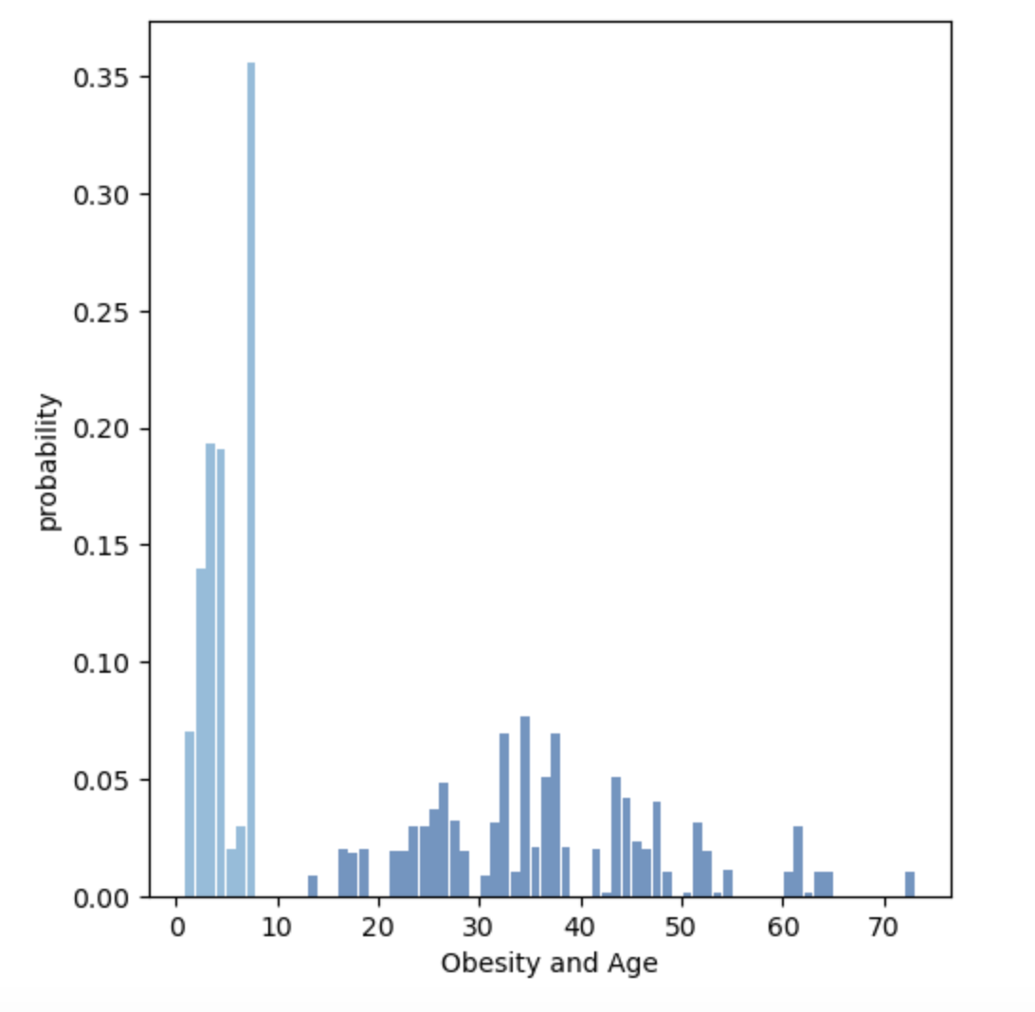
Obesity Vs Age

Slide 18
Summary of The PMF Comparisons
Based on the PMFs the probability one would have cancer at the age of 35 is much higher than the other ages.
For obesity, the highest probability that someone has cancer is on the high end of the scale which was 8.
The highest probability that someone was exposed to air pollution that caused cancer was on level 7.
Smoking seems to change a bit, for passive smokers the highest probability is on the low end of the scale, around 2. For smokers, the highest probabilities are about level 2 and 8. However, the probability doesn't seem to drop by much outside of these values.

Slide 19
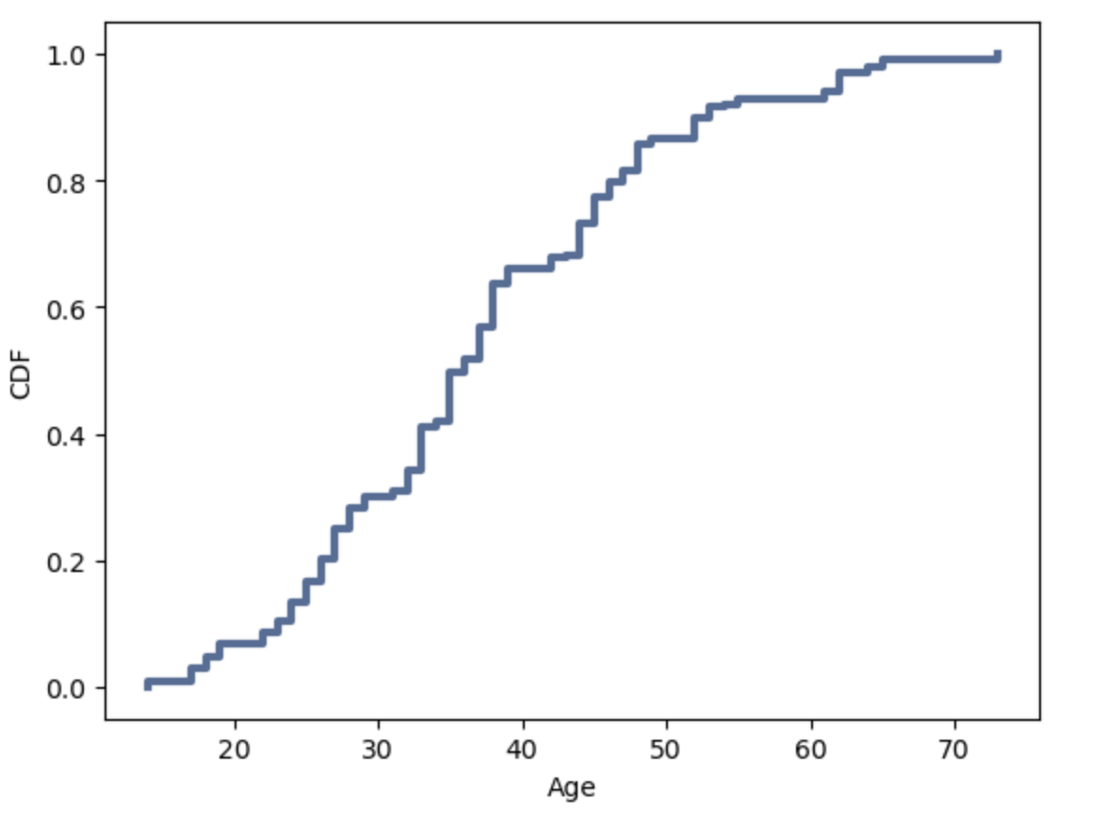
CDF of Age

Slide 20
Analysis of CDF
The Age CDF is a step function, but the steps are so close it nearly resembles a log function. A log-based model would be a good representation of age as the values don't seem to deviate too much from the mean.
If one were to plot the CDF for the remaining values, they would create a clearer stepwise function that deviate from the expected outcome on a log scale.
For age you tend to have a separate probability for each age. For the remaining variables they would fall more into range of probability. One probability could cover more than one exposure value.

Slide 21
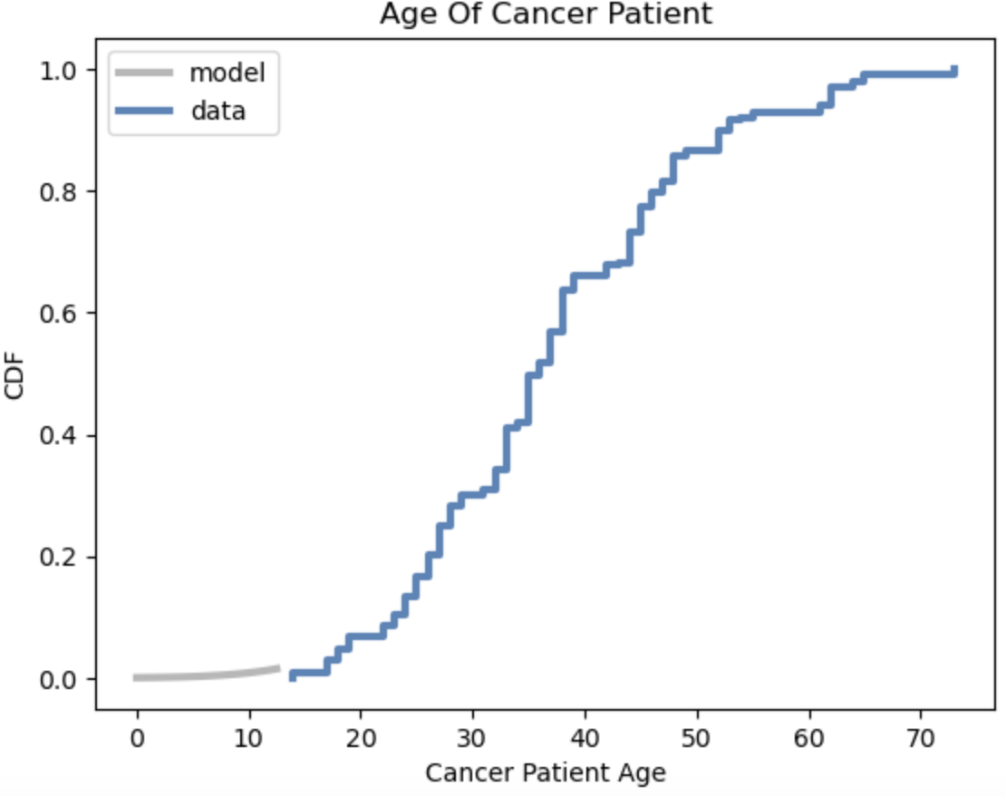
Analytical Distribution

Slide 22
Analytical Distribution Cont.
To verify if age will assist in comparing the 4 different causes in cancer, I'm made a log function model of the data.
The data fits well to this function as there is very little variance from the model.
This is significant to the data as one could provide an age and this model would indicate the likelihood that they may have cancer.
This should also make a great baseline to compare the remaining 4 variables.

Slide 23
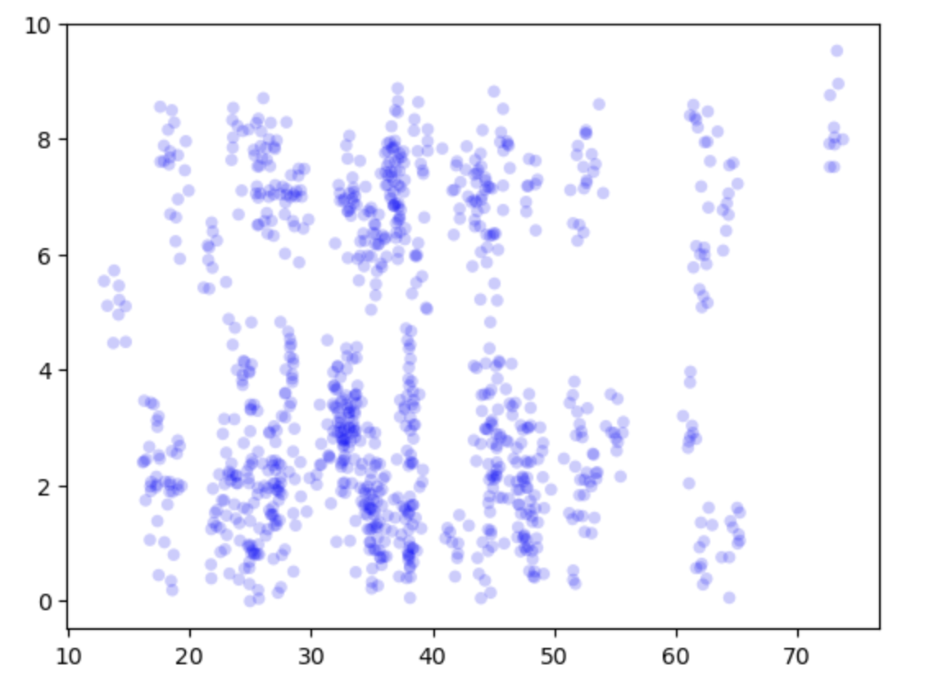
Smoker vs Age Scatter Plot

Slide 24
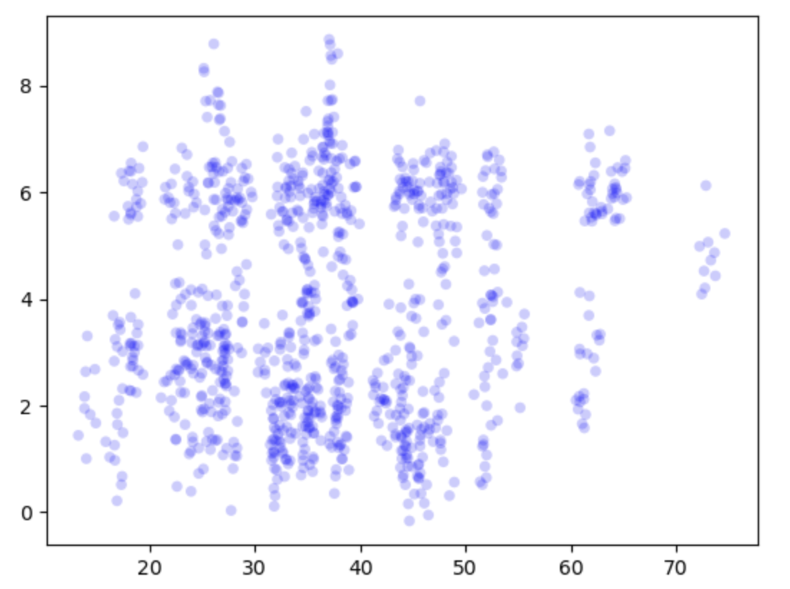
Air Pollution vs Age Scatter Plot

Slide 25
Analysis of scatter plots
Using the jitter method on the scatter plot, as age increases there seems to be an increased risk of cancer in smokers. Air pollution seems to increase the risk as well. This could mean that it affects all ages the same. However, neither appear to be linear relationships.
For both variables the covariance is relatively weak but it's slightly stronger in air pollution. The smoker covariance is at 2.25 while air pollution is 2.42
Not one variable chosen has a strong correlation to cancer. If spearman correlation is used, smokers are 0.04 while pollution is 0.06 which is the highest of the 4. However, the values are indicicitive of a postive relationship.

Slide 26
Hypothesis Test
Chi Squared was used as the test method.
While using this method on smokers the value returned is 1576.3. This is a large value so there is significant difference between the observed and the expected values.
All variables that were used returned a large Chi Square test. The lowest two were pollution and obesity. Pollution was 1072.5 while obesity was 1010.2. This would mean that they may not be good representative variables for the population and that smoking may not always be the leading cause of cancer

Slide 27
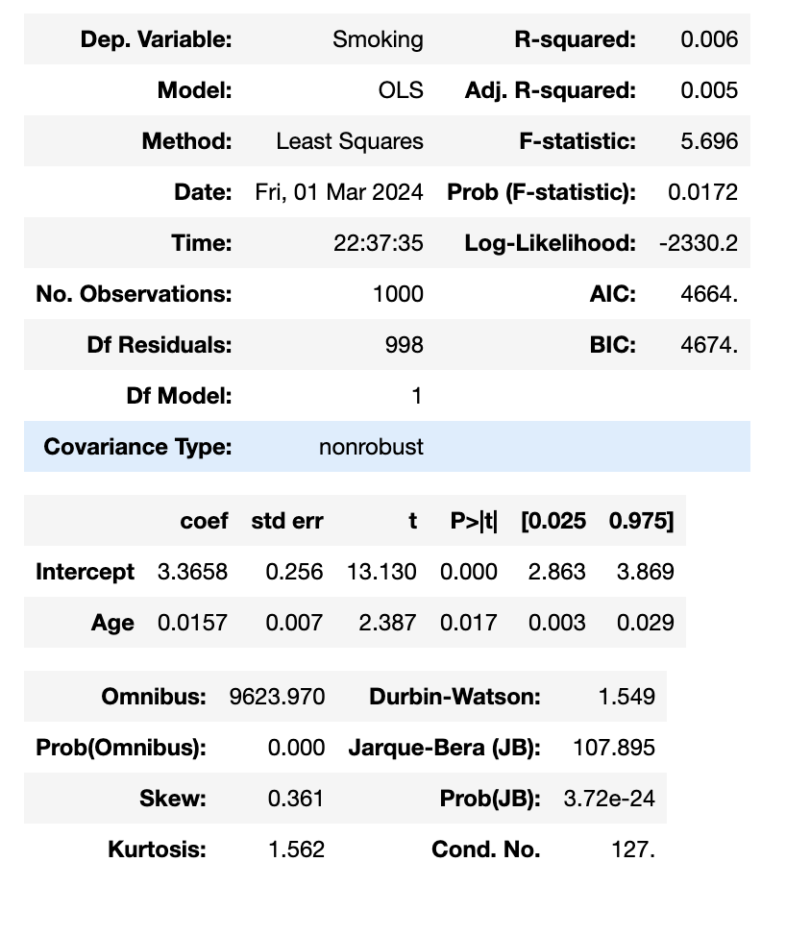
Regression Analysis of Smoking

Slide 28
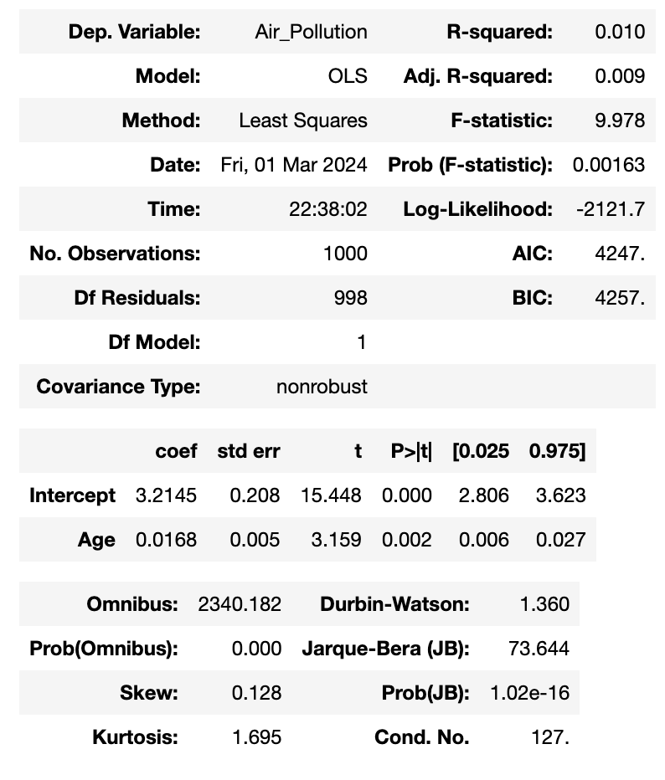
Regression Analysis of Air Pollution

Slide 29
Summary of Regression Analysis
A regression analysis was complete on each variable. Passive smoking and obesity had an r square of 0 and .001 respectively. This would mean that they nearly represent 0% of the population of cancer patients.
Air Pollution as an r value of 0.1 and would make up 10% of the population.
Smoking has an r value of 7.7 or smoking affected 7.7% of the population.
Thus, the null hypothesis is true, and smoking is not the leading cause of cancer based on this data set.

Slide 30
Work Cited
Damarla, Rishi. “Cancer Patients Data.” Kaggle, 4 Sept. 2020, www.kaggle.com/datasets/rishidamarla/cancer-patients-data.

